Slide 1
Introduction to Bioinformatics
Multiple Sequence Alignment
Running
MUSCLE & MAFFT
Online
Dr. Muhammad Tahir
Assistant Professor
CUI, Attock Campus

Slide 2
maximum file size of 1 MB.
MAFFT (Multiple Alignment using Fast Fourier Transform) is a high speed multiple sequence alignment program.

Slide 3
MUSCLE (Multiple Sequence Alignment)
MUSCLE stands for MUltiple Sequence Comparison by Log- Expectation.
MUSCLE is a multiple sequence alignment program.
MUSCLE has better speed than ClustalW2 or T-Coffee.
maximum file size of 1 MB.

Slide 4
MUSCLE
• MUltiple Sequence Comparison by Log-Expectation
• Better
average
accuracy
and
better
speed
than
ClustalW2 or T-Coffee
• An accurate MSA tool, especially good with proteins
and suitable for medium alignments.
• Aligns 5000 sequences with average length of 350.
• MUSLE algorithm includes
-fast distance estimation using kmer counting.
-progressive
alignment
using
a
new
profile
^{function called the log}‐^{expectation score.}
-refinement
partitioning.
using
^{tree}‐^{dependent}
restricted

Slide 5
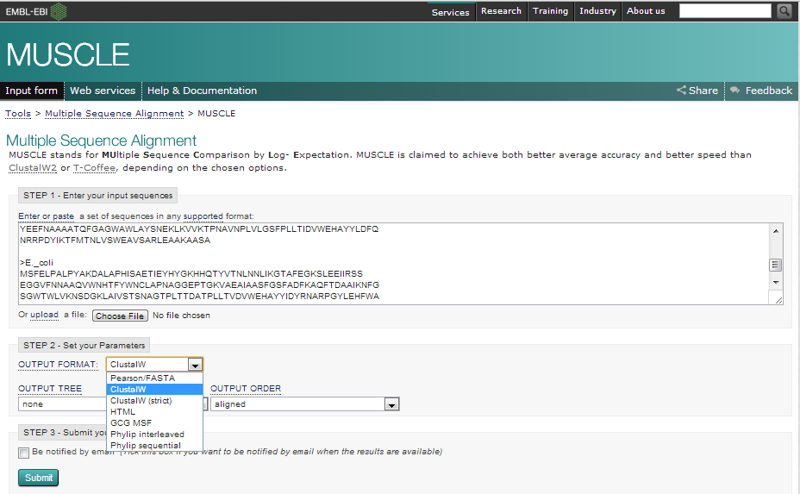
MUSCLE MSA interface at EBI (http://www.ebi.ac.uk/Tools/msa/muscle/)

Slide 6
1.
Go to http://www.ebi.ac.uk/Tools/msa/muscle/ in your
browser.
Enter your input sequence.
Go to choose file and give your input sequence in any
2.
3.
valid
format
(GCG,
FASTA,
EMBL,
GenBank,
PIR,
NBRF or UniProtKB/Swiss-Prot format).
Similarly give other input sequences (There is currently a limit of 500 sequences and 1MB of data).
4.
5.
Click
on
‘more
options’ button
to
set
the alignment
options. Change output format to clustalW to get results
in aln format. Default value is Pearson/FASTA [fasta].
Output
Order -in
which
the
sequences
appear
in
the
final alignment. Default value is: ‘aligned’.
Enter submit.
6.

Slide 7
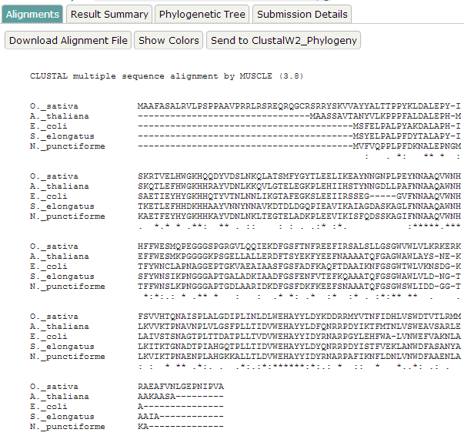
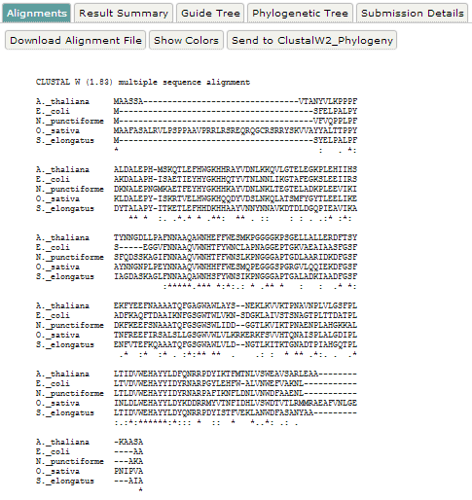
MSA generated by MUSCLE
MSA generated by T-Coffee
Comparison of MSA generated by
MUSCLE and T-Coffee

Slide 8
Both the programs use different algorithms,
which
is
clearly
by each
evident
program.
from
It has
the
results
noted
generated
to
be
that,
though alignments
differ,
conservation
of
amino acids
at
the
active site
are
still retained.
Again a phylogenetic tree construction is purely
dependent
on the
alignment.
Hence
one
should
utmost care in MSA.

Slide 9
• ‘Alignment’ tab (default) -shows the alignment in aln format.
• By default an alignment will display the following symbols that
denote the degree of conservation observed in each column:
"*" -residues or nucleotides in that column are identical in all sequences in the alignment.
":" -conserved substitutions have been observed.
"." -semi-conserved substitutions are observed.
• ‘Download Alignment File’ - to download the alignment in .aln
format.
• ‘Show Colors’ -the alignment will be shown in colour.
• ‘ClustalW2_Phylogeny’- MSA can be directly parsed to
ClustalW2 Phylogeny program. This allows the user to control the method of tree construction.

Slide 10
•
‘Result Summary’ -displays the result files comprising the
input
sequences for
the
alignment (.input),
tool
output
(.output), which is a
log file created during the alignment,
alignment
in
HTML
format
(.html),
alignment
in
PHYLIP
format (.phylip), alignment in CLUSTAL format (.clustalw),
alignment in MSF format (.msf) and guide tree (.dnd) that
contains
the
information
for building
the
cladogram
or
phylogram.
‘Start JalView’ under JalView -triggers JalView, a Java based editor in new window. This requires Java program to be preinstalled.
‘Phylogeny Tree’ -displays the phylogenetic tree of the sequences used. It is actually a Neighbour-joining tree without correcting the distances
Submission Details’ -displays the information regarding the program used, its version, input parameters, etc
•
•
•

Slide 11
MAFFT
• Multiple Alignment using Fast Fourier Transform.
• It uses FFT and is suitable for medium-large sequence alignments.
• computational time is drastically reduced.
•
1st
- homologous regions are identified by FFT,
amino acid sequence
sequence composed of
volume + polarity values of each amino acid residue.
•
2nd
-simplified scoring system is used for reducing
computational time and increasing the accuracy of
alignments.

Slide 12
• Applicable for
-sequences
extensions
having
large
insertions
or
-distantly related sequences of similar length
• Methods
Progressive
method
(FFT-NS-2)
-
with
computational
time
is
drastically
reduced
comparable accuracy
Iterative
times
refinement
method
(FFT-NS-i)
–is
100
faster
than
T-COFFEE
without
sacrificing the
accuracy.

Slide 13
Iterative method
• Problems in progressive alignment method
-errors
in
the
initial alignments
of
the
most
closely related sequences are propagated to the MSA.
-problem is
more acute when
the
_{starting}
^{related}
_{alignments}
^{sequences.}
are
between
more
distantly
• Iterative methods
–rectify
this
problem
by
repeatedly
realigning
subgroups of the sequences.
-then
by aligning
these
subgroups into a
global
alignment of all of the sequences.
-Major
objective is
to improve
the overall
alignment score, such as a sum of pairs score.
• Selection of groups -based on the ordering of the sequences on a phylogenetic tree.

Slide 14
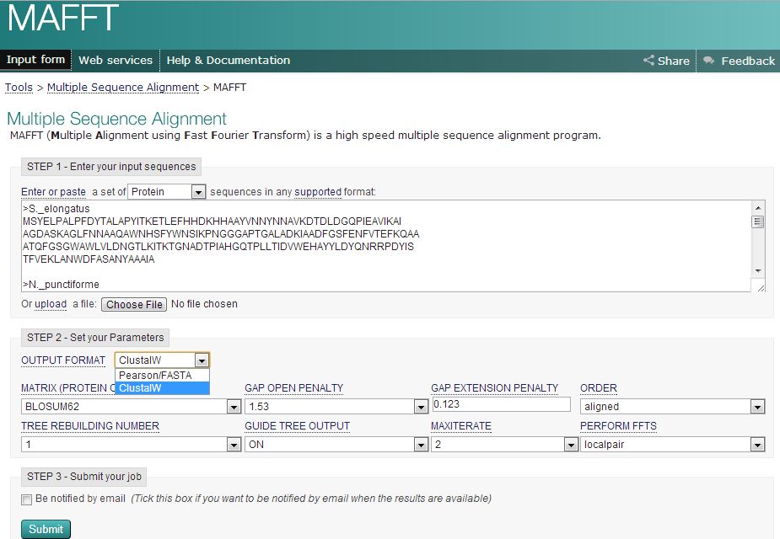
MAFFT MSA interface at EBI (http://www.ebi.ac.uk/Tools/msa/mafft/)

Slide 15
•Click on ‘more options’ button to set the alignment options
Change the
output
format
‘clustalw’
(Default
value
is:
Pearson/FASTA [fasta]).
Matrix
Protein comparison matrix alignment.
Matrix (Protein Only) Default value is: BLOSUM Gap Open
to be used
when
adding
sequences
to
the
62 [bl62]
Penalty for first base/residue in a gap.
Default value is: 1.53
Gap Extension
Penalty for each additional base/residue
Default value is: 0.123
in a gap.

Slide 16
Order
The order in which the sequences
Default value is: aligned Tree Rebuilding Number Default value is: 1
Guide Tree Output Generate guide tree file Default value is: ON [true] Max Iterate
appear
in
the
final
alignment
Maximum number of
alignment.
iterations
to perform
when
refining
the
Change
the Max Iterate
value
to
‘2’ to
change
number
of
iterations for better alignment.
Default value is: 0
Perform FFTS (Fast Fourier Transform)
Default value is: local pair
• Click ‘submit’

Slide 17
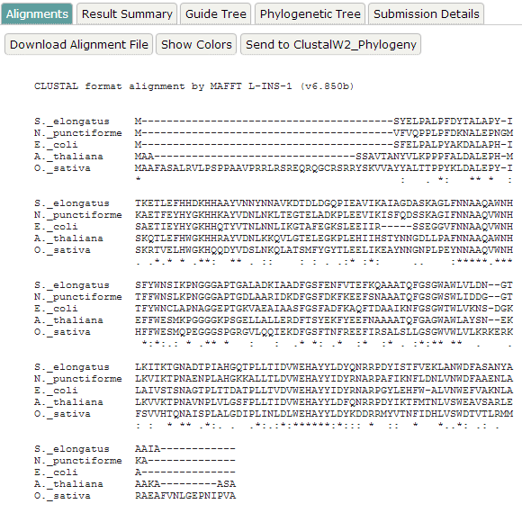
MSA generated by MAFFT

Slide 18
• The
N
terminal
alignment
in
the
result
generated by the MAFFT is similar to the one
generated by the T-Coffee.
• The alignment is in the middle and C terminal
is
entirely
different
from the
T-Coffee
or
MUSCLE.
• Though alignments
differ, conservation
of
amino acids at the active site are retained.

Slide 19
Formats
Gaps in sequences
• In all EMBOSS alignment formats, gaps indicated by ‘-' character.
• Exception
-msf format which uses '.' as the gap character inside the sequences
-'~' as the gap character at the terminal ends of the alignment.

Slide 20
Head and tail of the format
• The majority of the alignment formats (except those that are also standard sequence formats, like fasta or MSF) have a block of information at the start of the alignment describing the program, date, output filename, ID names of the sequences and some of the parameters and statistics of the alignment.
########################################
# Program: demoalign
# Rundate: Thu Jan 17 09:30:08 2002
# Report_file: stdout
########################################
#===================================== Aligned_sequences: 4
# 1: IXI_234
# 2: IXI_235
# 3: IXI_236
# 4: IXI_237
# Matrix: EBLOSUM62
# Gap_penalty: 9
^{# Extend_penalty: ‐1}
##
Length: 131
# Identity: 95/131 (72.5%)
# Similarity: 127/131 (96.9%)
# Gaps: 25/131 (19.1%)
#
9/27/2016 Alignment Formats http://emboss.sourceforge.net/docs/themes/AlignFormats.html 3/6
# #====================================
There is also a block of information at the end of the alignment for summary information. This is used by a few programs e.g. merger.

Slide 21
Length
The header block contains a line similar to:
# Length: 131
This is the length of the alignment, including any gaps that have been introduced to construct
the alignment.
Identity
The header block contains a line similar to:
# Identity: 95/131 (72.5%)
This is a count of the number of positions over the length of the alignment where all of the residues or bases at that position are identical. It is followed by '/131' the length of the alignment and '(72.5%)'
the percentage of positions in the alignment where there are identities.
Similarity
The header block contains a line similar to:
# Similarity: 127/131 (96.9%)
This is a count of the number of positions over the length of the alignment where >= 51% of the residues or bases at that position are similar. Any two residues or bases are defined as similar when they have positive comparisons (as defined by the comparison matrix being used in the alignment algorithm). It is followed by '/131' the length of the alignment and '(96.9%)' the percentage of positions in the alignment where there are similarities. Note that the sum of identical and similar positions is greater than 100%. This is because the count of similar positions includes the count of identical positions; if residues are identical,
they must also be similar.

Slide 22
Gaps
The header block contains a line similar to:
# Gaps: 25/131 (19.1%)
This is a count of the number of positions over the length of the alignment where there are one or more sequences with a gap.
9/27/2016 Alignment Formats
http://emboss.sourceforge.net/docs/themes/AlignFormat s.html4/6
It is followed by '/131' the length of the alignment and
'(19.1%)' the percentage of positions in the alignment where there are gaps.

Slide 23
Score
The header block may contain a line similar to:
# Score: 100.0
This is the score used by the program that calculated the alignment to determine which is the best possible alignment to report. The algorithm that was used to derive the score is not part of the alignment formatting routines. You should see documentation about the relevant algorithm to see how the score is derived.
Markup Line
The markup line is the line commonly placed between a pairwise alignment or at the bottom of alignments of 3 or more sequences that shows where sequences are mismatched, gapped, identical or similar. In general the markup line uses a space for a mismatch or a gap, '.' for any small positive score, ':' for a similarity which scores more than 1.0, and '|' for an identity where both sequences have the same residue regardless of its score ('W' matching 'W' scores much more than 'L' matching 'L' because a conserved tryptophan is more significant than a conserved leucine). The 'markx' set of alignment formats (produced by the FASTA suite of programs written by Bill Pearson) use '.' for similarity and ':' for an identity. The '|' character is not used. This was a design decision by Bill Pearson when he wrote the FASTA programs.

Slide 24
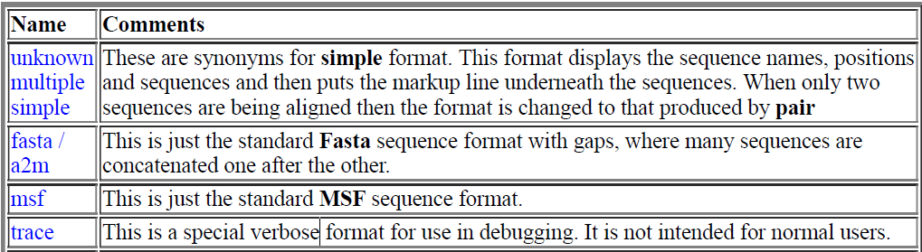
Alignment Formats (MSA)

Slide 25
Alignment viewers/editors
Name
Integrated with Struct. Prediction Tools
Can Align
Sequences
Can Calculate Phylogenetic Trees
Other Features
Formats
Supported
License
Link
AliView
2016
No
Muscle is integrated. Other programs such as MAFFT can be
defined.
External programs such as FastTree
can be called from within
Fast, very easy navigation through unlimited mouse wheel zoom in/out feature. Handles unlimited file size alignments. Degenerate primer design.
FASTA, PHYLIP, Nexus, MSF and Clustal
GPL3
(http://www.ormb
unkar.se/aliview)
BioEdit
No
ClustalW
rudimentary, can read phylip
plasmid drawing, ABI chromatograms
Genbank, Fasta, Phylip
3.2, Phylip 4, NBRF/PIR
Free
(http://www.mbio. ncsu.edu/BioEdi t/bioedit.html)
CINEMA
NO, but can
read/show
2D structure annotations
ClustalW
No
Dotplot, 6 frame
translation, Blast
Nexus, MSF, Clustal, FASTA, PHYLIP,
PIR, PRINTS
Free
(http://aig.cs. man.ac.uk/researc h/utopia/cinema/c inema.php)
DECIPHER
Yes
Yes
UPGMA, NJ,
ML
Primer/Probe design, Chimera finding
FASTA, FASTQ, GenBank
GPL
(http://deciphe r.cee.wisc.edu/Do wnload.html)
MEGA
No
Native
ClustalW
UPGMA, NJ, ME, MP, with bootstrap and confidence
test
extended support to phylogenetics analysis
FASTA, Clustal, Nexus, Mega, etc..
Freeware, registration requested
(http://www.m egasoftware.net/), table offeatures (http://www.mega software.net/feat ures.html)

Slide 26
Other Tools
• DbClustal
Create a MSA from a protein BLAST result using the
DbClustal program.
• MView
Transform a Sequence Similarity Search result into a MSA or
reformat a MSA using the MView program.
• WebPRANK
The EBI has a new phylogeny-aware MSA program which makes use of evolutionary information to help place insertions and deletions.

Slide 27
END

